Slide 1
Applying Data Science to Suricata
Anomaly Hunting with Suricata & Splunk

Slide 2
Disclaimer
During the course of this presentation, we may make forward looking statements regarding future events or the expected performance of the company. We caution you that such statements reflect our current expectations and estimates based on factors currently known to us and that actual events or results could differ materially. For important factors that may cause actual results to differ from those contained in our forward-looking statements, please review our filings with the SEC. The forward-looking statements made in the this presentation are being made as of the time and date of its live presentation. If reviewed after its live presentation, this presentation may not contain current or accurate information. We do not assume any obligation to update any forward looking statements we may make. In addition, any information about our roadmap outlines our general product direction and is subject to change at any time without notice. It is for informational purposes only and shall not, be incorporated into any contract or other commitment. Splunk undertakes no obligation either to develop the features or functionality described or to include any such feature or functionality in a future release.

Slide 3
Speaker’s Bio
Anthony Tellez
Splunk Public Sector Federal Team
Previously @ NGA
Splunkbase App Developer
Interests
Machine Learning
National Security
Internet of Things
https://github.com/anthonygtellez/
https://github.com/anthonygtellez/TA-Suricata
https://github.com/anthonygtellez/TA-sshd_auth

Slide 4
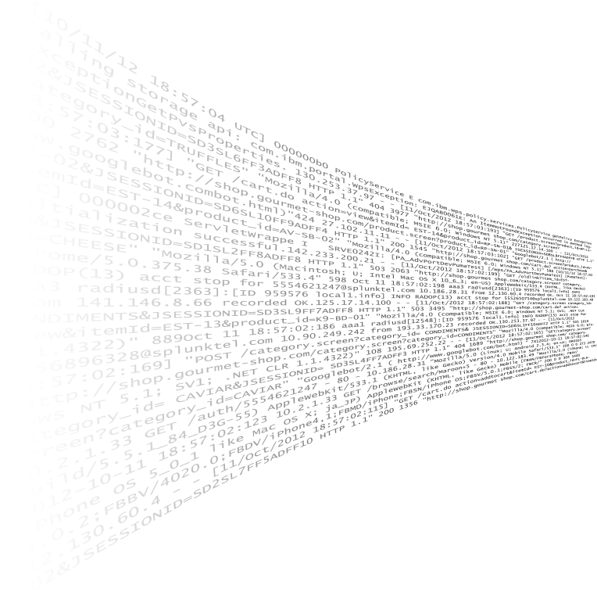

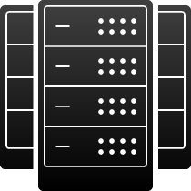



























Turning Machine Data Into Business Value
Index Untapped Data: Any Source, Type, Volume
Ask Any Question
Application Delivery
Online Services
On-
Premises
Web Services
IT Operations
Servers
Security
GPS Location
Packaged Applications
Networks
Private Cloud
Desktops
Security, Compliance, and Fraud
Storage
Custom
Applications
Messaging
Telecoms
RFID
Online Shopping Cart
Energy Meters
Business Analytics
Databases
Public Cloud
Web Clickstreams
Call Detail Records
Industrial Data and the Internet of Things
Smartphones and Devices
Notes:
Splunk products are being used for data volumes ranging from gigabytes to hundreds of terabytes per day. Splunk software reliably collects and indexes machine data, from a single source to tens of thousands of sources. All in real time. Once data is in Splunk Enterprise, you can search, analyze, report on and share insights form your data. The Splunk Enterprise platform is optimized for real-time, low-latency and interactivity, making it easy to explore, analyze and visualize your data. This is described as Operational Intelligence.
The insights gained from machine data support a number of use cases and can drive value across your organization.
[In North America]
Splunk Cloud is available in North America and offers Splunk Enterprise as a cloud-based service – essentially empowering you with Operational Intelligence without any operational effort.

Slide 5
What is Data Science?
“Data science is the civil engineering of data. Its acolytes possess a practical knowledge of tools and materials, coupled with a theoretical understanding of what’s possible.”
-Mike Driscoll CEO, Metamarket
Notes:
Data Science is a framework for answering IT questions, we need SME’s which understand the data or domain and use descriptive statistics and other tools to try to determine the answer to that question. The formation of a hypothesis or null hypothesis is an important part of this process as it allows us to scope which SME’s, and data sources are needed.

Slide 6


Agenda
Data Science Methodology for Security Ops
Quantitative vs Qualitative Analysis
Exploratory Data Analysis (EDA)
Machine Learning

Slide 7
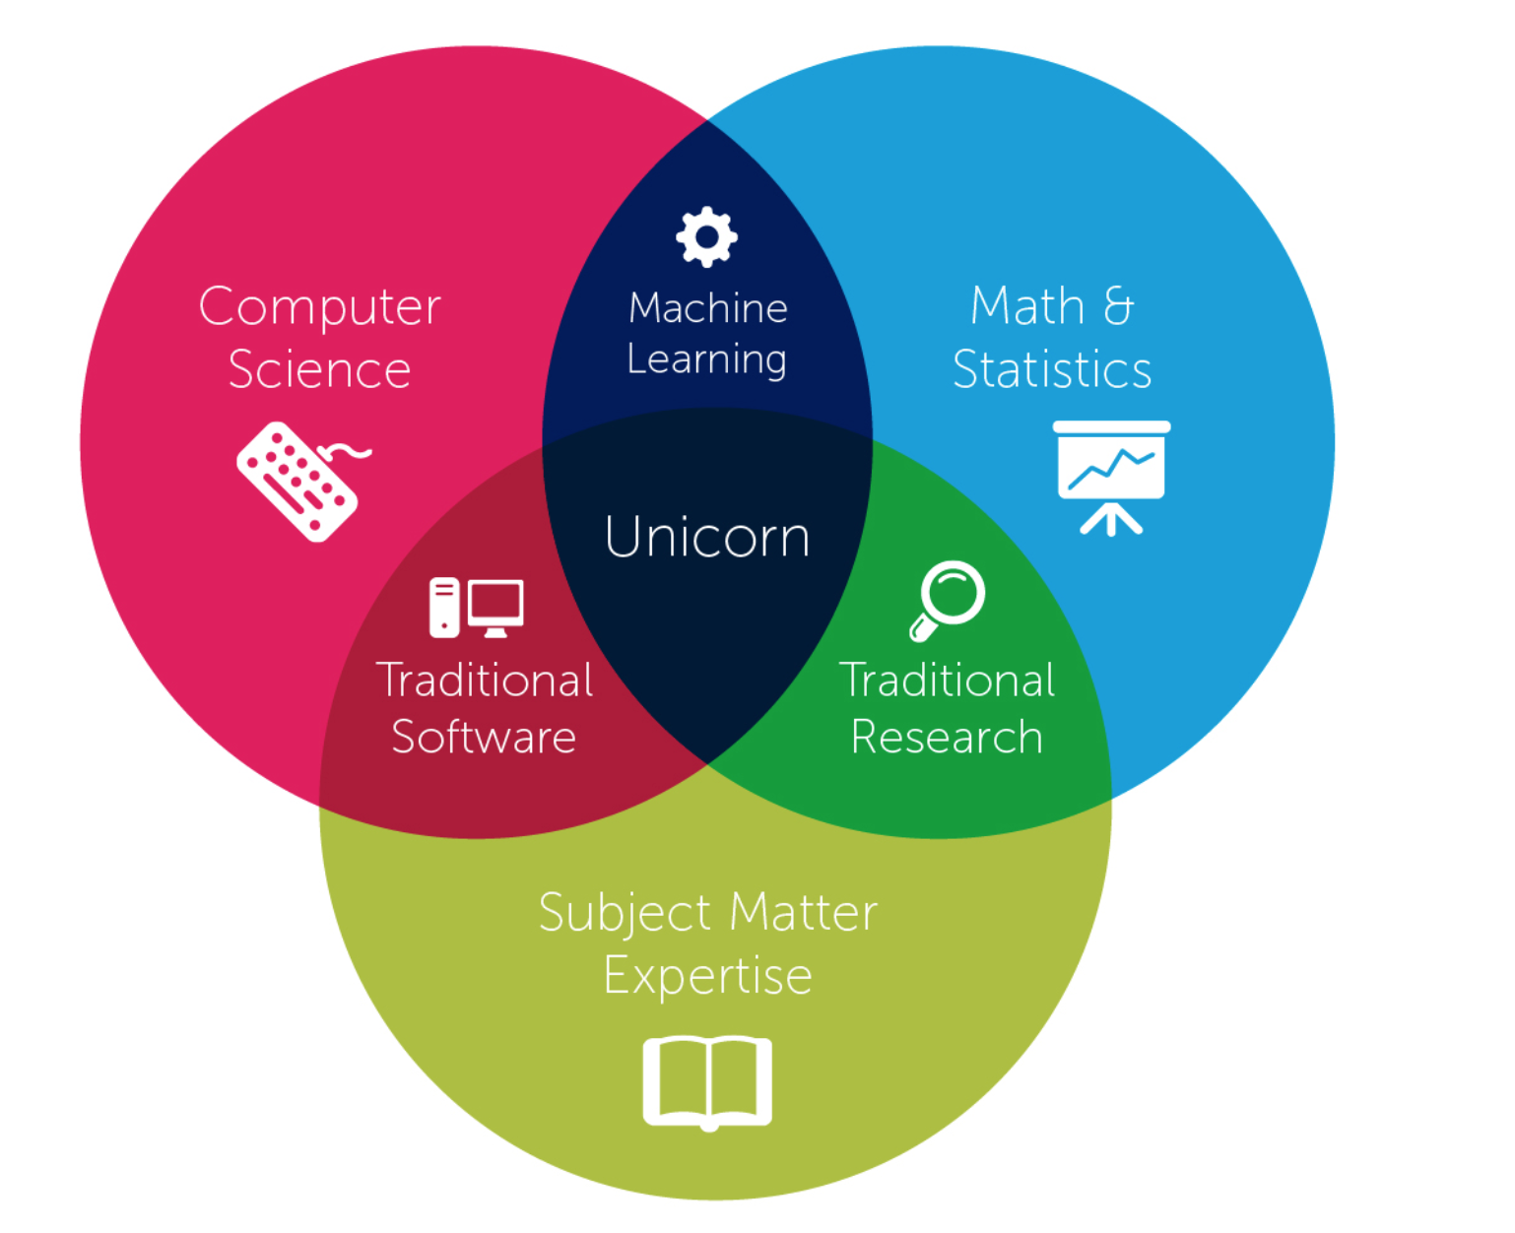
Security Data Analysis
Information Overload
IDS alerts, Virus Scans, tools.
Multidisciplinary approach is needed for next gen problems
SIEM alone, ML alone, are not enough without SME.
Our goal is to empower security analysts to reach the middle using statistical techniques built into many SIEMs.
Everyone is capable of becoming a unicorn.
Notes:
Transparency into every system is a double edged sword because of information overload.
Non subject matter experts focus on static metrics and fail to dynamically adjust thresholds.
Our goal is to empower the SOC analyst to move away from static thresholds, and arbitrary Boolean logic. Everyone is capable of becoming a unicorn.

Slide 8
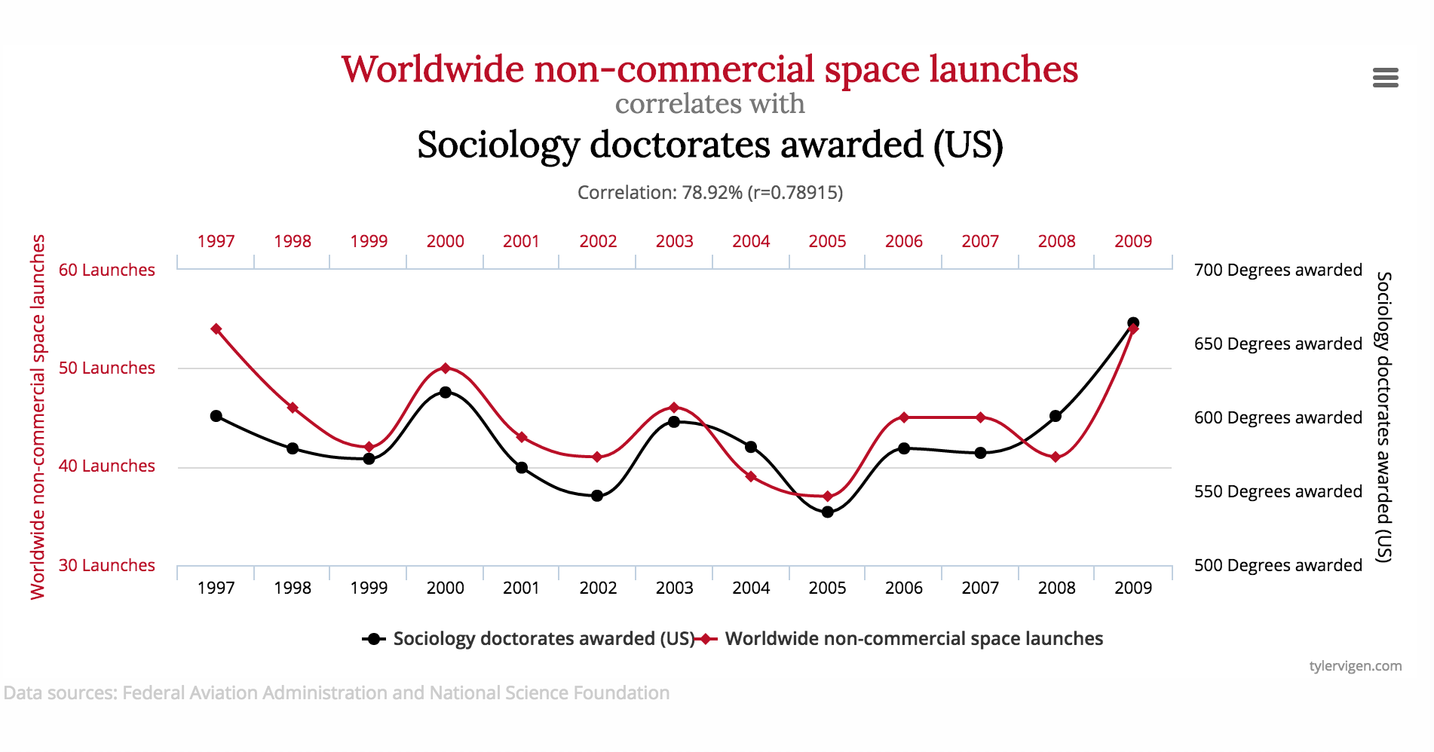
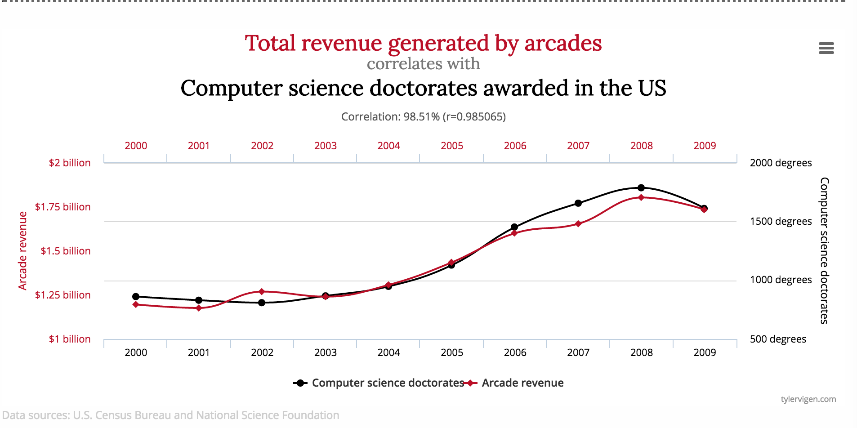

Correlation != Causation ☹
Correlating some data may be a waste of time if you don’t have an understanding of what the data represents.
A good example of why you need a SME

Slide 9
5 Step Data Science Methodology for Security OPS
Step 1
Scope relevant machine data to onboard.
Step 2
Collect requirements and validate relevant machine data.
Step 3
Exploratory Data Analysis. (Searching & Visualizing!)
Step 4
Formulate hypothesis working with Domain Experts.
Step 5
Test and repeat steps as needed until hypothesis is answered.

Slide 10







Applying Data Science to Security OPS
Step 1
Scope relevant machine data to onboard.
Data Sources: – /var/log/auth.log – All Network Traffic
Notes:
What is the question you are seeking to answer? What data do you need to answer this question? (AKA Scoping and developing use cases with Sales Engineering and Professional Services)

Slide 11
Security Patterns in Machine Data
What To Look For | Data Source
Abnormally high number of file transfers to USB or CD/DVD | Operating system
Abnormally high number of files or records downloaded from an internal file store or database containing confidential information | File server / Database
Abnormally large amount of data emailed to personal webmail accounts or uploaded to external file hosting site | Email server / web proxy
Unusual physical access attempts (after hours, accessing unauthorized area, etc.) | Physical badge records / Authentication
Excessive printer activity and employee is on an internal watch list as result of demotion / poor review / impending layoff | Printer logs / HR systems
User name of terminated employee accessing internal system | Authentication / HR systems
IT Administrator performing an excessive amount of file deletions on critical servers or password resets on critical applications (rogue IT administrator) | Operating system /Authentication / Asset DB
Employee not taking any vacation time or logging into critical systems while on vacation (concealing fraud) | HR systems / Authentications
Long running sessions, bandwidth imbalance between client & server, Bad SSL Configurations | IPS / IDS / Stream
Known cloud or malware domains, bad SSL Configurations | Threat Intelligence, Custom Lookups
High Entropy Subdomains | Web proxy, DNS, Wiredata
Notes:
Understanding what questions data answers can be summarized by this table. The first 5 are related to data exfiltration and detecting insider threats, the remaining data sources are high value sources for detecting malware and advanced persistent threats.

Slide 12
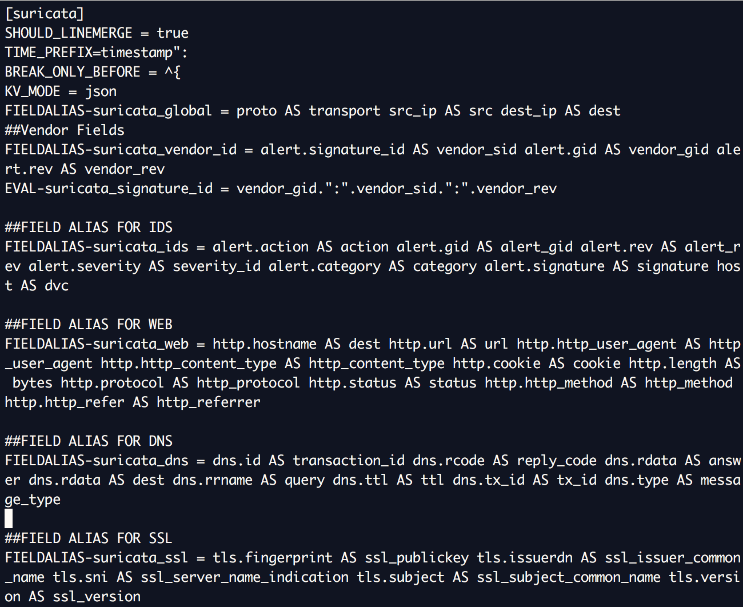
Applying Data Science to Security OPS
Step 1
Scope relevant machine data to onboard.
Step 2
Collect requirements and validate relevant machine data.
Example Collection Methods
Universal Forwarder / Agent on Endpoints
/var/log/suricata/eve.json
/var/log/auth.log
Example Validation Methods
Add Ons (TA-Suricata, & TA-sshd_auth) / SIEM Parsers
Regex to build additional fields
Common Information Model
Notes:
Define technicals about how do we collect the data source, then how to we confirm the data is usable?

Slide 13
Applying Data Science to Security OPS
Step 1
Scope relevant machine data to onboard.
Step 2
Collect requirements and validate relevant machine data.
Step 3
Exploratory Data Analysis. (Searching & Visualizing!)
Number of connections between src_ip & dest_ip, iplocation
Torrent activity (dest_port 6881-6889, 6969), connections to Tor Addresses, or Malware domains
Interesting Fields: http_user_agent, http_method, bytes
Descriptive Statistics: Producer Consumer Ratio Categories Bytes_in/Bytes_Total | Bytes_out /Bytes_total
Notes:
What are the relationships that exist in the data? Are there user activities you would not expect?

Slide 14
Applying Data Science to Security OPS
Step 1
Scope relevant machine data to onboard.
Step 2
Collect requirements and validate relevant machine data.
Step 3
Exploratory Data Analysis. (Searching & Visualizing!)
Step 4
Formulate hypothesis working with Domain Experts.
Is this real torrent traffic or another application using the same ports?
Can users install or run TOR Browser onto their desktops in this VLAN?
Is this SQL injection valid in user_agent field or just bad parsing of data during the onboarding process?
Can I disprove the activity by adding more data or context?
Notes:
How do we validate or disprove those activities? It is always better to be critical of an activity than accept it at face-value. (False Positives)

Slide 15
Relevant Data Sources
Raw Data | Lookups | Context | Value
Firewall Traffic | Username to IP | 10.0.0.12 fails to login to 5 different servers | Determine user responsible
Proxy | Username to IP | 10.0.0.12 visits Dropbox and uploads 1TB of data | Determine user responsible
Active Directory | User to Group Mapping | SPLUNK\JohnDoe authenticates to 30 different hosts in 30 second period | Determine scope of compromise, domain admin, SQL admin only?
DHCP | User to IP, Host to IP | 10.0.0.12, 10.0.0.35 attempt to connect to TOR IP address | Determine user or hosts responsible
Email Transport | Baseline Usage | User sends email with large file attachments | Determine normal behavior
Exchange / Email | Baseline usage | User sends 40 emails in 60 minute period | Determine normal behavior
Packet Capture / Wire Data | Subnet to physical location / priority of asset | 10.0.0.0/27 shows successful SSH connections originating from Russia | Determine where an asset is physically or scope of compromise based on VLAN
Notes:
creating value from raw data with lookups
the context describes the situation - domain expertise from your organization
top example - read it is contextual but static

Slide 16
Applying Data Science to Security OPS
Step 1
Scope relevant machine data to onboard.
Step 2
Collect requirements and validate relevant machine data.
Step 3
Exploratory Data Analysis. (Searching & Visualizing!)
Step 4
Formulate hypothesis working with Domain Experts.
Step 5
Test and repeat steps as needed until hypothesis is answered.
Notes:
If you can’t answer the question, either you don’t have enough data or you don’t have the right experts in the room to interpret the results.

Slide 17

Applying Data Science to Security OPS
Step 1
Scope relevant machine data to onboard.
Step 2
Collect requirements and validate relevant machine data.
Step 3
Exploratory Data Analysis. (Searching & Visualizing!)
Step 4
Formulate hypothesis working with Domain Experts.
Step 5
Test and repeat steps as needed until hypothesis is answered.
Notes:
So start from the beginning and add more data until you can answer the question or ask the right questions of your data.

Slide 18

Quantitative vs Qualitative Analysis
Quantitative measure:
25 GB of Data uploaded in 60 mins
Threshold and periodicity fixed
Qualitative measure:
The data uploaded during abnormal time periods.
Threshold and periodicity is variable
Notes:
Creating alerts with static thresholds are not very precise easy to miss your target Use the word static here when describing quantitative alerts/searches

Slide 19
Quantitative
X
Enterprise Security version 2 - 3
| tstats `summariesonly` sum(Web.bytes_out) as bytes_out from datamodel=Web where Web.bytes_out>0 by Web.src,Web.dest | `drop_dm_object_name("Web")` | search bytes_out>10485760 | `get_asset(src)` | search (src_priority=high OR src_priority=critical)
What does correlation rule this mean?? - Summarize Bytes Out by source, trigger when bytes out exceeds 10485760 and the asset is tagged by the user as high or critical.
- Rule fails when asset isn’t tagged properly, or bytes is only 10485759, doesn’t take time into context. (Would 10485760 bytes be acceptable over 1 year, 30 days, 1hour?)
Notes:
An example of that kind of STATIC analysis

Slide 20
Qualitative
Enterprise Security 3 - 4+ SA-ExtremeSearch
Create the model in a Context
Count traffic by src in 30m (Takes time into account) √ | tstats `summariesonly` dc(All_Traffic.src) as src_count from datamodel=Network_Traffic.All_Traffic by _time span=30m Gather stats median, min, max, (descriptive statistics) per src√
| stats count, median(total_count) as median, stdev(total_count) as size | search size>0
Create a context with current stats per src √
| xsupdateddcontext name=count_30m container=network_traffic terms="minimal,low,medium,high,extreme" type=median_centered width=3 app=SA-NetworkProtection scope=app | stats count
Time Range -25h to -1h

Slide 21
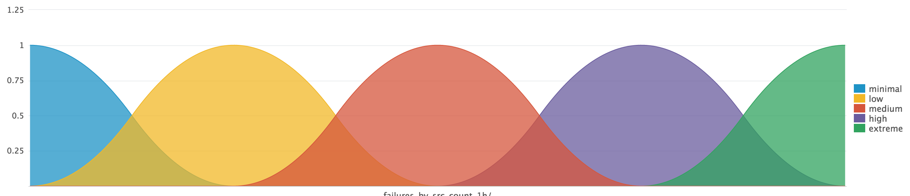
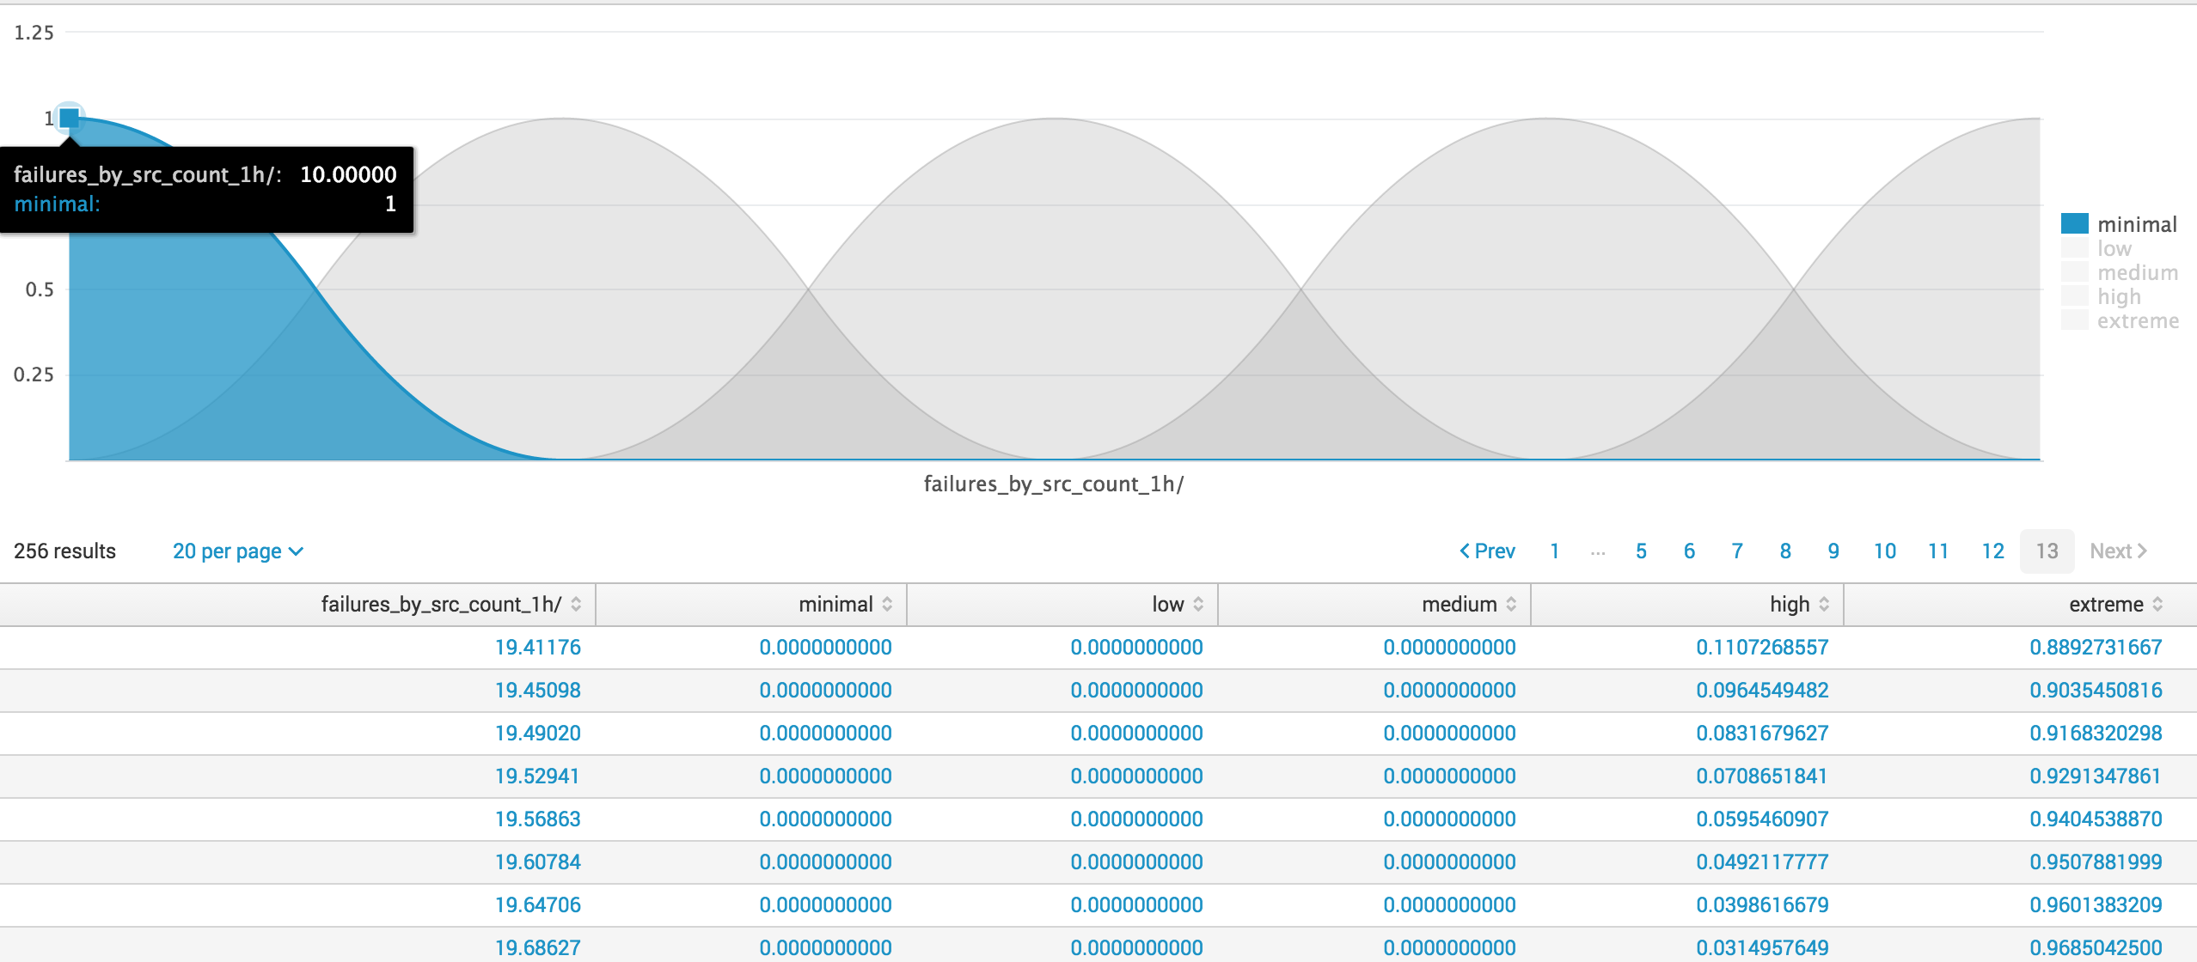
Visualize Context
Notes:
Range from 0 to 1, is the correlation of how well this value fits into that category
This the the world of gray
We are looking of the users activity and how close that behavior
The tails show what range of values are associated with the category, e.g. extreme, high.....

Slide 22
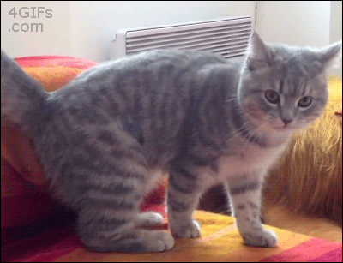
Static to Dynamic Thresholds
Quantitate v. Qualitative
Exploratory Data Analysis
Descriptive Statistics + Moving Window = Context
Visualization
Entropy & Correlation
Machine Learning
Supervised v. Unsupervised
Security Application of ML
Adaptive Thresholding

Slide 23
EDA - Descriptive Statistics
In high school statistics you learned about mean, mode, median, min, max, & frequency aka “Descriptive Statistics”.
You should make use of these to describe the data you are looking at, explore potential relationships within your data, and ask questions of your data.
This iterative process is called “Exploratory Data Analysis” it is critical to Machine Learning and Security Analytics.
Notes:
Descriptive Statistics and Exploratory Data Analysis (EDA)

Slide 24
EDA - Descriptive Statistics
Compare different duration times of data set for a specific time period.
index=suricata event_type=flow | stats count as number_events, min(duration) as min_duration, max(duration) as max_duration, avg(duration) as avg_duration, median(duration) as median_duration, perc95(duration) as perc95_duration, stdev(duration) as stdev_duration
Are there any long running sessions in the last 60 minutes?
Notes:
This gives us an overall view of long running sessions in the environment. Skew, Range, St Deviation from Mean or Median. We can now categorize a session (Flow) using this framework.

Slide 25

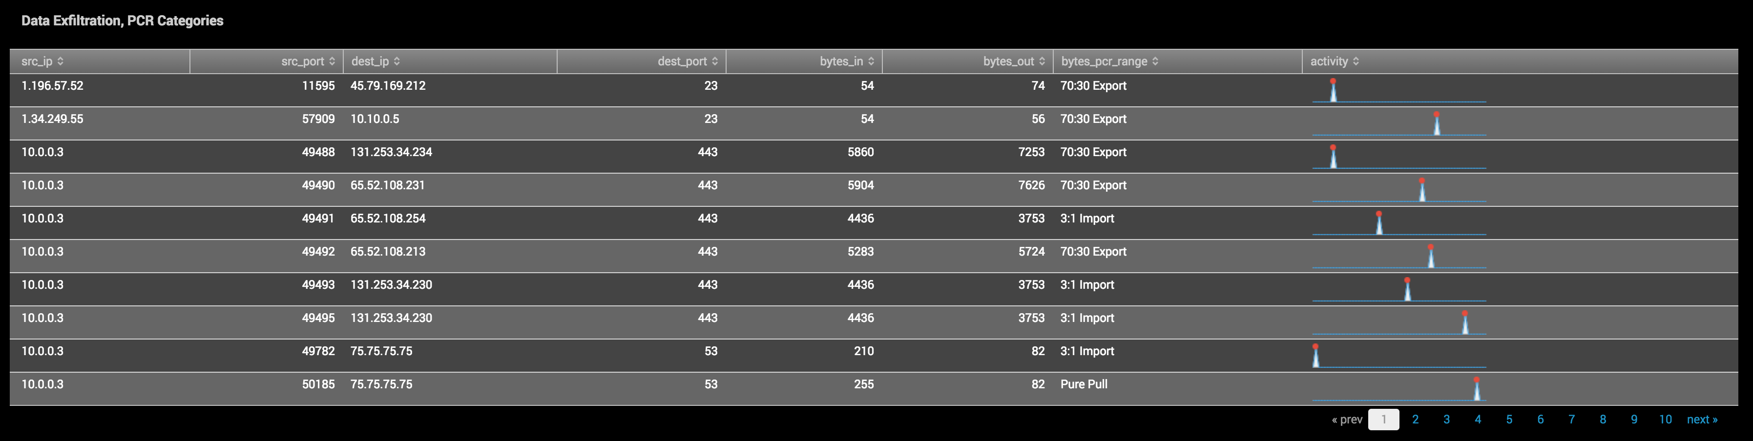
Applying Descriptive Statistics - PCR
Describing network flows with Producer Consumer Ratio (PCR)
Create a ratio of bytes_in to bytes_out
Apply case logic to determine inbound or outbound imbalance between client & server
index=suricata event_type=flow | eval bytes_total=bytes_in+bytes_out | eval bytes_ratio= ((bytes_out-bytes_in)/bytes_total) | eval bytes_pcr_range = case(bytes_ratio > 0.4, "Pure Push", bytes_ratio > 0, "70:30 Export", bytes_ratio == 0, "Balanced Exchange", bytes_ratio >= -0.5, "3:1 Import", bytes_ratio > -1, "Pure Pull") | stats sparkline(count) AS activity by src_ip src_port dest_ip dest_port bytes_in bytes_out bytes_pcr_range
PCR Ranges:
1.0 – Pure Push - FTP upload, multicast, beaconing
0.4 – 70:30 export - Sending Email
0.0 – Balanced Exchange - NTP, ARP probe
-0.5 – 3:1 import - HTTP Browsing
-1.0 – pure pull - HTTP Download
Notes:
Proposed at last years flowcon – FlowCon, Shows the relationship between client and server. Question I am asking is what is the balance of bytes_in/bytes_out?
Is this a balanced exchange and can I categorize a src_ip or user based on data flow? How often is this activity happening, and using a moving window how does the ratio change?

Slide 26
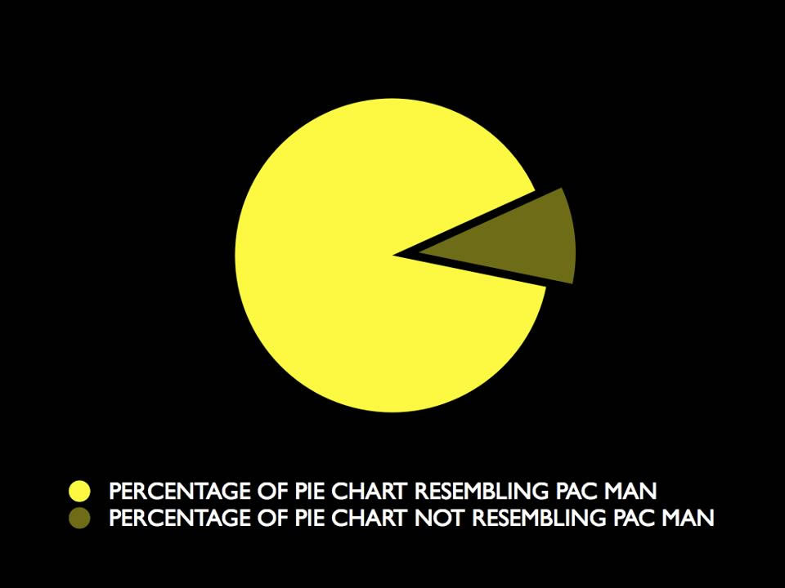
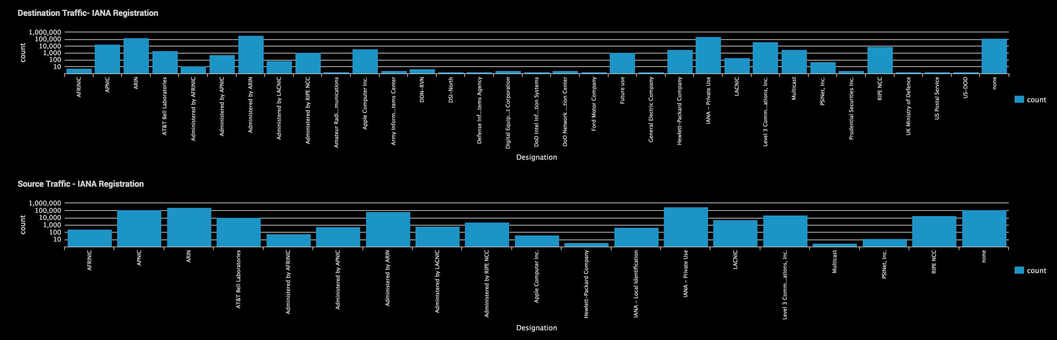
Visualization & Creating Context (EDA)
Visualization is a powerful EDA tool
Not everything can be described as bits, bytes, plaintext or pie charts.
Correlation to add context to your data during the EDA process or test hypothesis.
Notes:
We can also use visualization as a tool for understanding and exploring our data. Not everything is useful in csv, excel, email. In this example I am looking at connection attempts and IANA registration. I can learn about the distribution of data and start to formulate new questions about botnets operating from those networks. Su

Slide 27
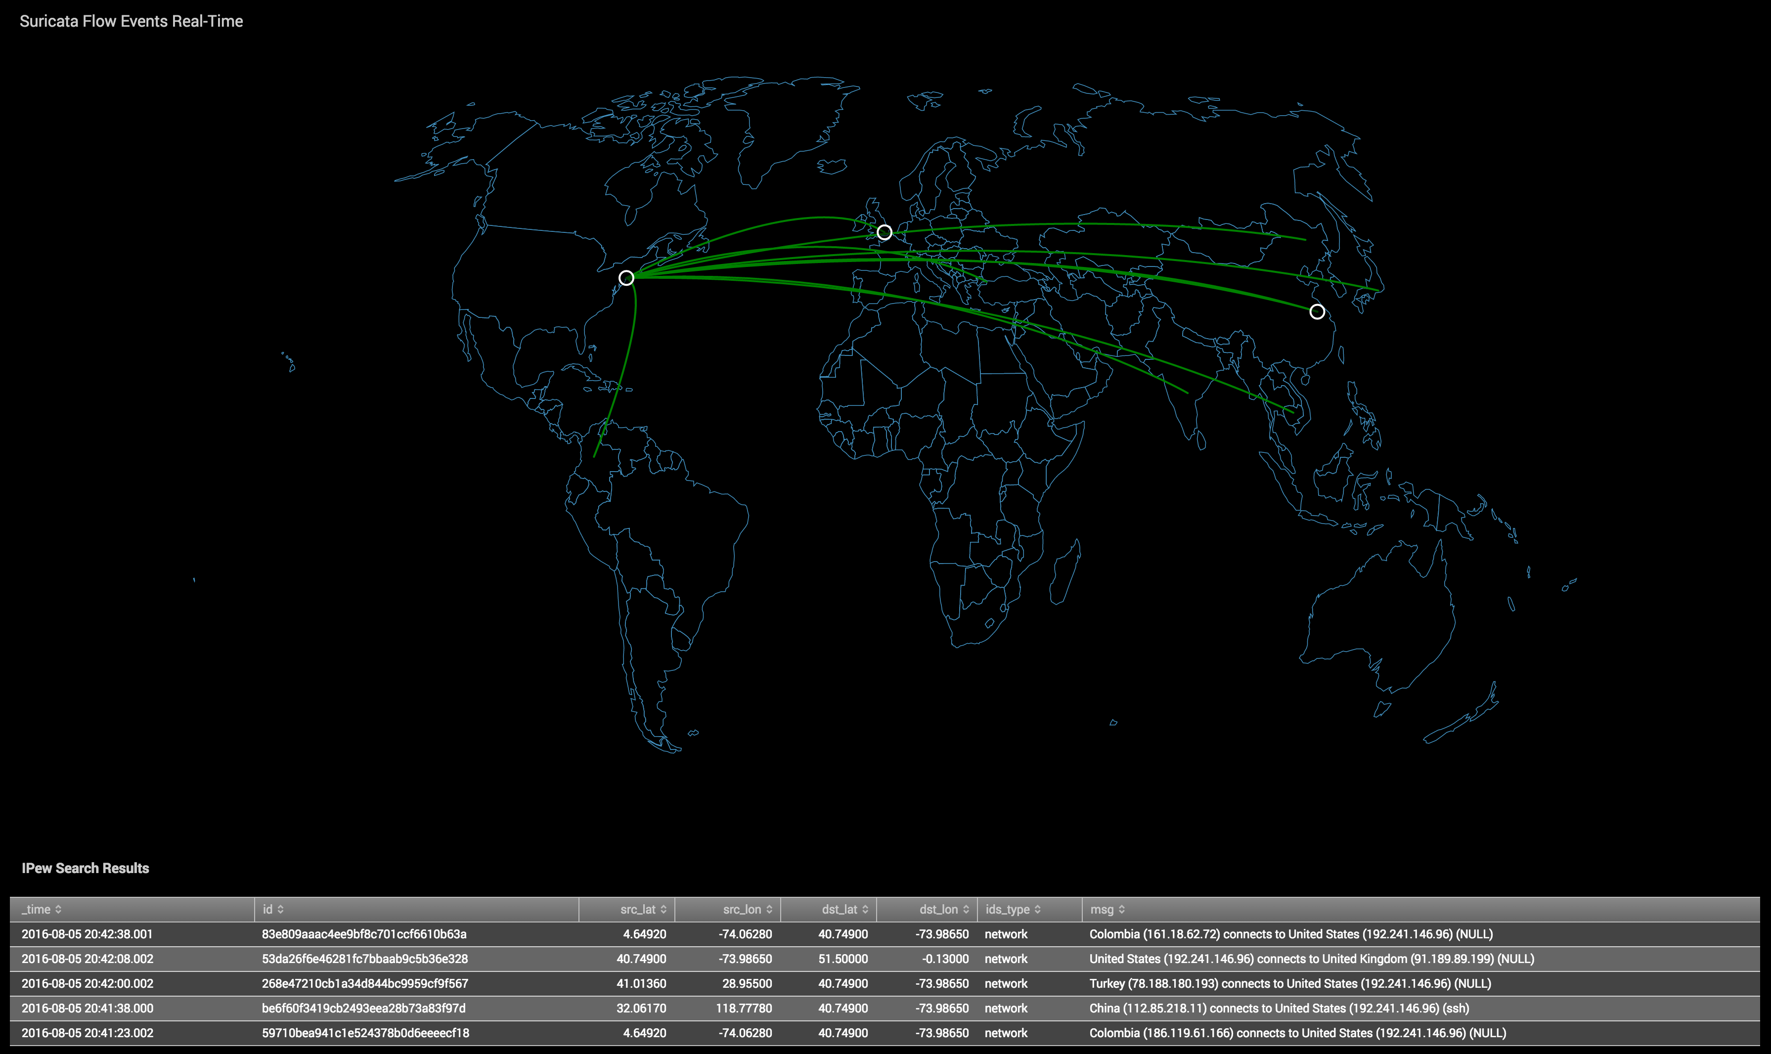
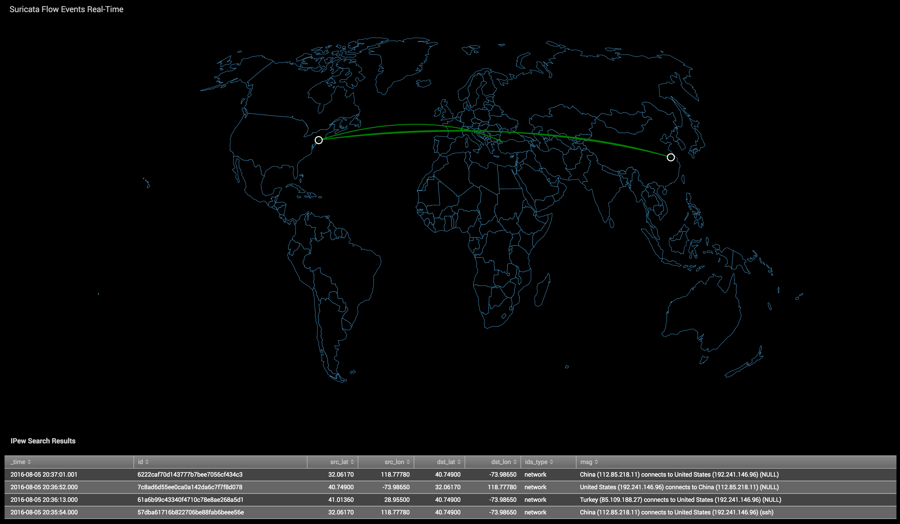
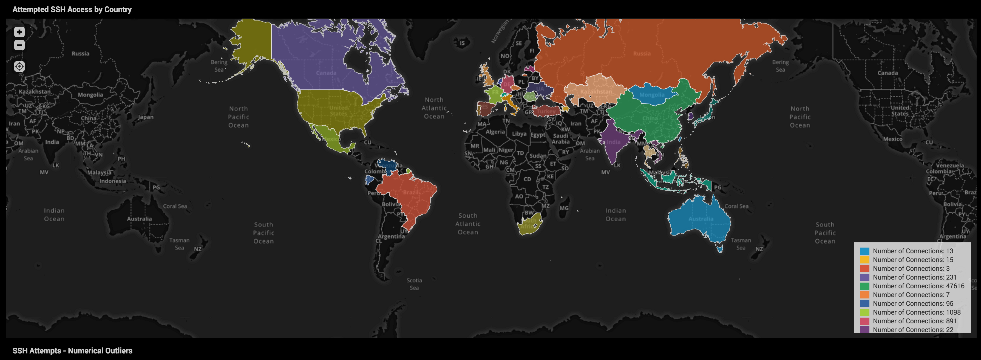
Geographical EDA - Visualization
Visualization useful for exploring multi-dimensional relationships.
Tells a story about the data you can’t describe in text or tables.
“Where are connections ‘originating’, and how often am I seeing this activity?”
I don’t remember hiring any remote employees in China.
Notes:
I can also visualize using geographical data, geoip is powerful for conveying a narrative which is difficult to describe using only logs. This might provoke new questions about the sheer number of connections from cyber adversaries, or unexpected traffic from a market you don’t do business.

Slide 28




Cool. So how do I operationalize this?
DNS Water Torture
Botnet sends queries with 16 letters randomly prepended to the victim’s domain.
xyuiasdfcosic.www.halpme.com
alkdfejenjasd.www.halpme.com
C&C Beaconing Activity (Dynamic DNS)
Advanced malware uses a Domain Generation Algorithm (Random Subdomain)
d0290d00xasdf.no-ip[.]org
Data Exfiltration
DNS Tunneling (Query)
dnscat.912701a98e9bde415c4ad70007beaf54d2
dnscat.925401a98ebe0cf540b20d001a4b5e726494b001bb4c192bb68fe73c000bf7c1c0e
Two Techniques to detect this activity in Suricata:
Shannon Entropy of DNS Query, HTTP destination
Character Length of DNS Query, HTTP destination
Notes:
You’re probably thinking, yeah those visuals are pretty great for non-security people, but how do I operationalize any of this to increase my security posture? The great thing about an analytics platform is it provides you the tools to look historically at your data and search for behaviors signature based systems may have missed. The platform provides you the opportunity to search for signatures that might be unique to a new ransomware campaign or data exfiltration by insiders by making use of mathematical calculations you cannot compute in real-time on a sensor on a per packet basis.

Slide 29
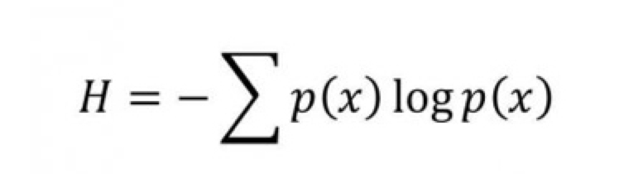
Shannon Entropy for EDA & Hunting
What is Shannon Entropy?
“… a measure of uncertainty in a random variable”
How does it help us find malware and anomalous activity?
The more random a string is, the higher its calculation of randomness.
aaaaa.com (Score 1.8)
Google.com (Score 2.6)
Ic49f66b73141b5c1.com (Score 4.1)
Domains and subdomains with high entropy are good indicators of malicious behavior.
We can filter to domains or subdomains with a score above 3 or 4.
Cons:
False positives
CDNs like Amazon, Akamai, and others use pseudorandom generated subdomains
Requires to you to keep a blacklist or whitelist of domains to reduce noise when hunting (but, relatively easy to do in Splunk)
Malware evolves
Locky & others using shorter subdomains or domains to reduce randomness, reducing entropy score
Notes:
There are numerous ransomware campaigns such as Locky, EK Neutrino and Angler which make use of high entropy subdomains and domains as part of the command & control process.

Slide 30

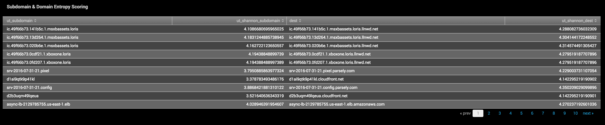
Shannon Entropy for EDA & Hunting
Python Lookups - Entropy Analysis of DNS / HTTP
# Full Query for Suricata HTTP
index=suricata host=suricata event_type=http | lookup ut_parse_extended_lookup url AS dest | lookup ut_shannon_lookup word AS ut_subdomain OUTPUT ut_shannon AS ut_shannon_subdomain | lookup ut_shannon_lookup word AS dest OUTPUT ut_shannon AS ut_shannon_dest | search ut_shannon_dest > 4 OR ut_shannon_subdomain > 4 | table ut_subdomain ut_shannon_subdomain dest ut_shannon_dest | dedup dest ut_subdomain
# Results of Suricata HTTP Entropy Scoring
Notes:
He’s an example of a search for high entropy subdomains & domains in Suricata http logs.

Slide 31
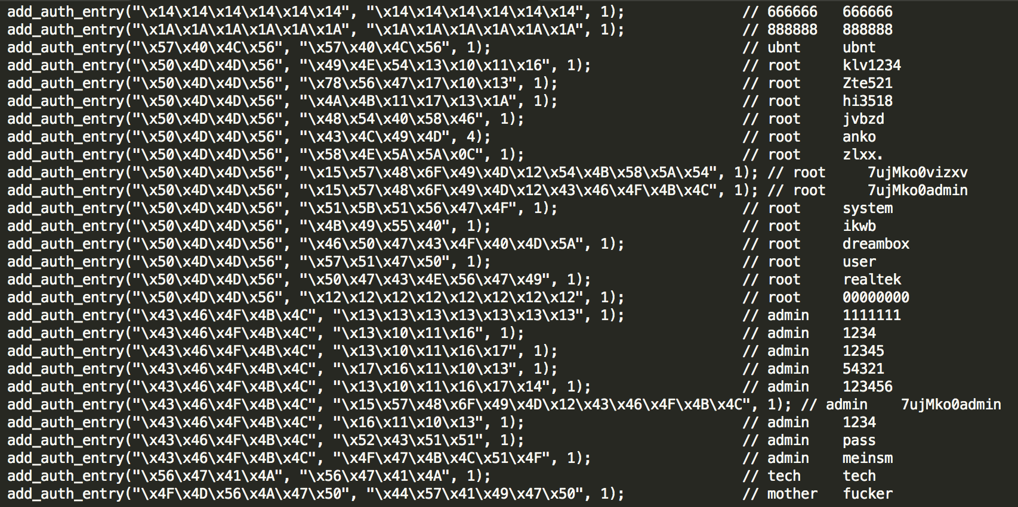
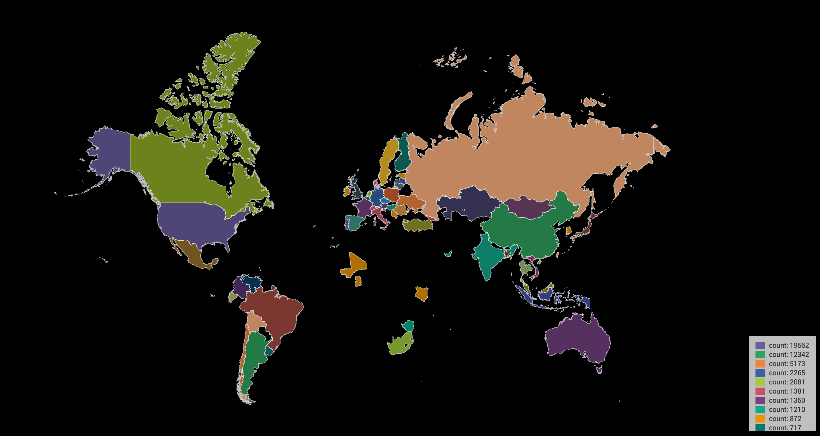

Correlation – Finding Mirai
Technique
Default credentials hard-coded in the Scanner.C module give us a behavioral signature to look for.
Telnet/SSH attempts using invalid users (tech, mother, ubnt, 666666, 888888) are unique to Mirai, & other botnets (post source code leak).
Correlate list of IPs with Suricata to find other activity from these IoT nodes attempting to breach my network.
Mirai Scanner.C module
Notes:
Mirai botnet, was the largest DDoS in recorded history when it attacked Brian Krebs blog with nearly 620GB/s of traffic from compromised IoT devices. Mirai beat that record later when it trashed DynDNS with a 1.2TB/s attack causing havoc on the East Coast. Prior to the DynDNS attack the source code was leaked likely in an effort to cover the tracks of the creator, giving security researchers a glimpse into the capabilities of Mirai.

Slide 32
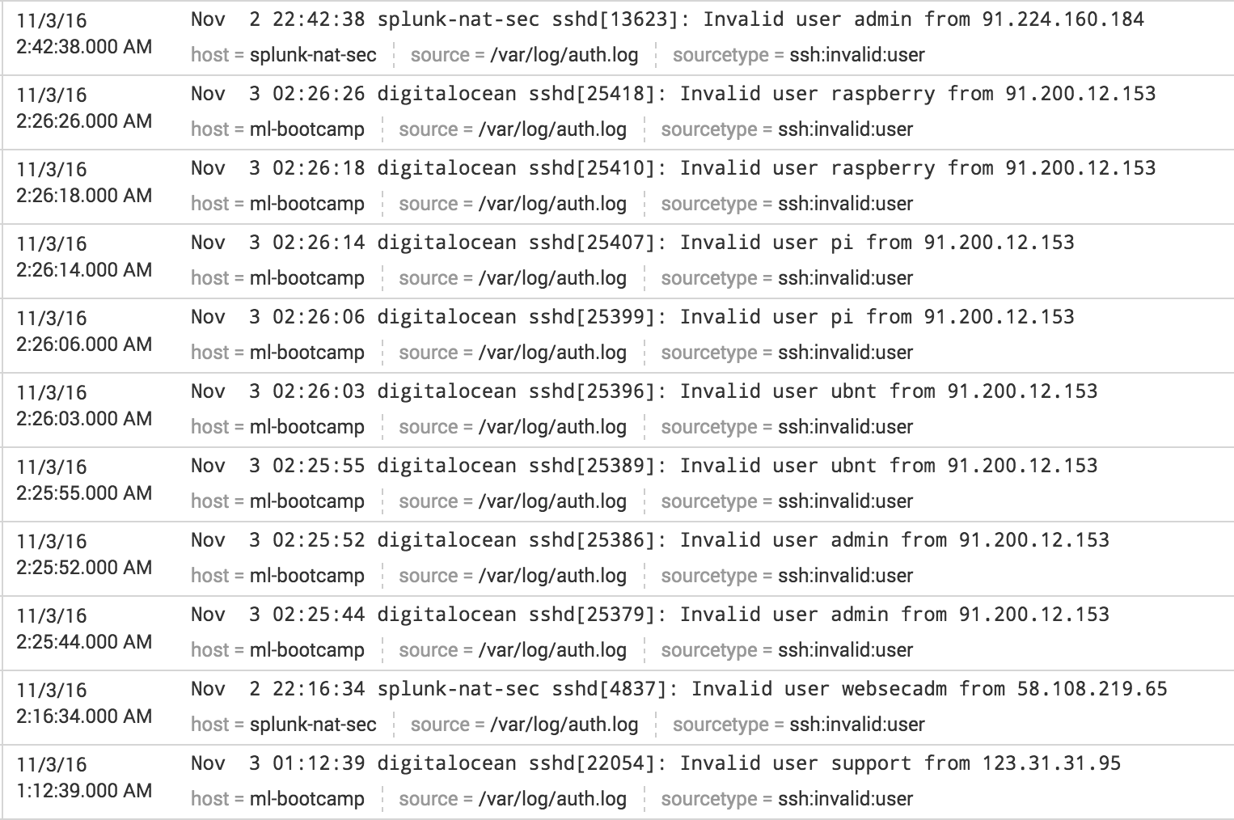
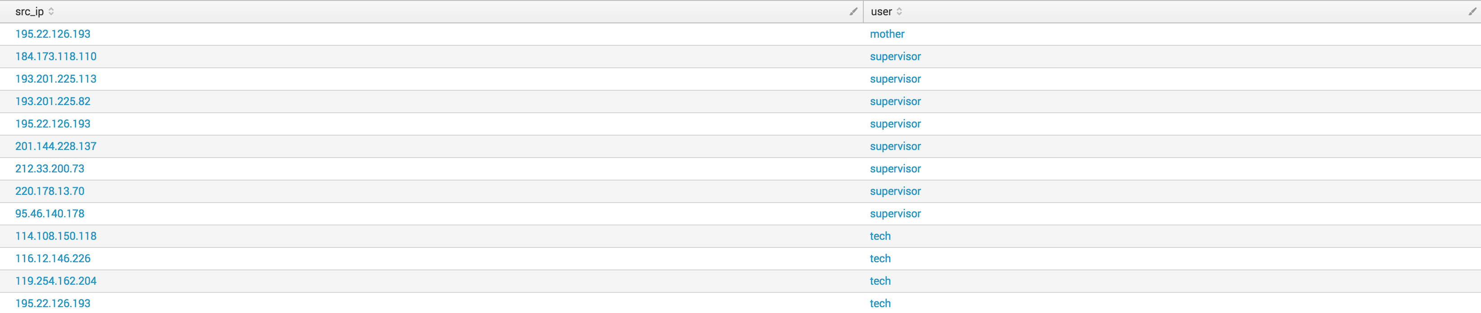
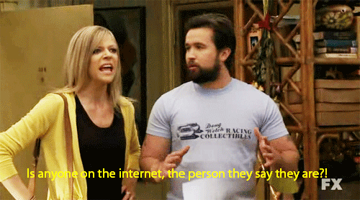
Finding Mirai – Behavioral & Contextual
Create CSV Lookup – Invalid users in /var/log/auth.log using information found in Source Code to create a Behavioral Signature
index=os operation="invalid user" | stats count by user src_ip | fields user src_ip | outputlookup all_invalid_logins.csv
Filter our CSV to invalid users unique to Mirai
|inputlookup all_invalid_logins.csv where user="ubnt" OR user="mother" OR user="666666" OR user="888888" OR user="supervisor" OR user=”tech"
Mirai Scanner.C Adapted to Scan for ARM?
Notes:
So this example is showcasing a search which creates a table of all invalid user logins in auth.log. We can see the raw log as it existed on disk, and how the search transforms it into a table with src_ip, and user. You can think of this as creating your own homebrew threat intelligence. An interesting thing to note is the Mirai botnet or a variant someone has created appears to also be searching for ARM devices.

Slide 33
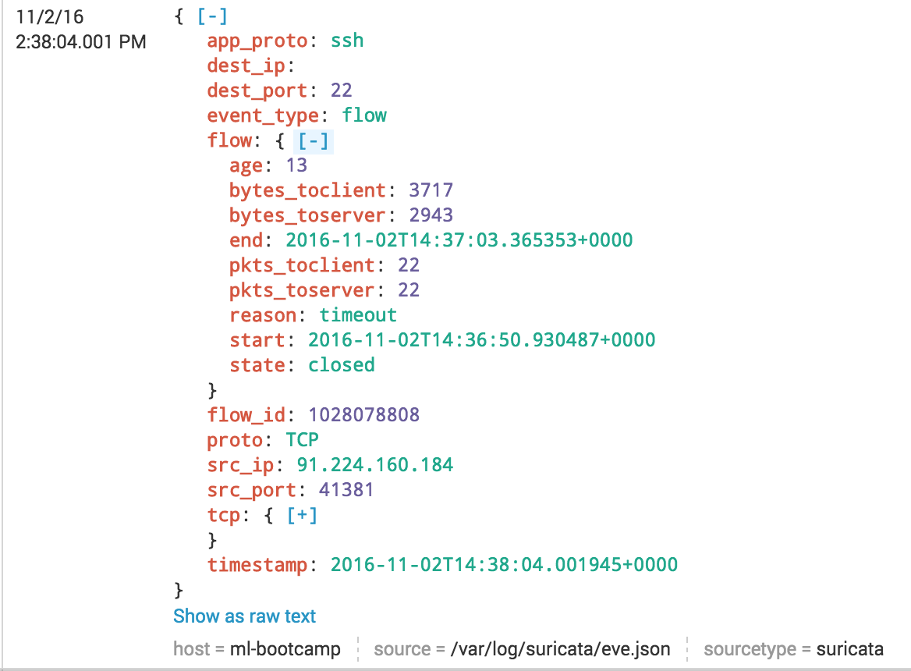
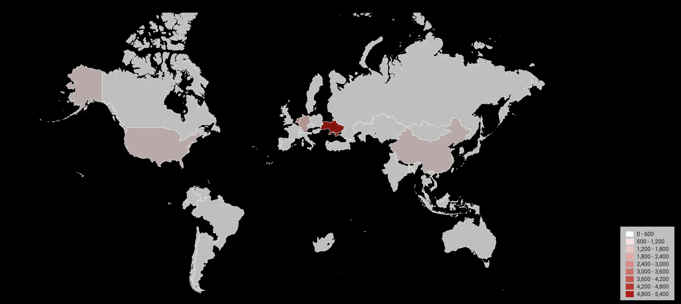
Finding Mirai – Behavioral & Contextual
Let’s correlate the invalid user IPs using Mirai Creds with our Suricata eve.json logs to see if there are any matches on our network!
index=suricata [ | inputlookup all_invalid_logins.csv where user="ubnt" OR user="mother" OR user="666666" OR user="888888" OR user="supervisor" OR user="tech" | table src_ip | dedup src_ip ]
Using MaxMind we can “geo-locate” the IoT devices trying to gain access:
| iplocation src_ip | stats count by Country | geom geo_countries featureIdField=Country
Notes:
Now that I have a list of src_ips with invalid users, I want to filter to the users Mirai was targeting in the Scanner.C module. I take the reduced subset of src_ips and correlate that with all of my Suricata data. That means the only data I am looking at from flow, http, tls, etc will have a src_ip from a likely Mirai node.

Slide 34
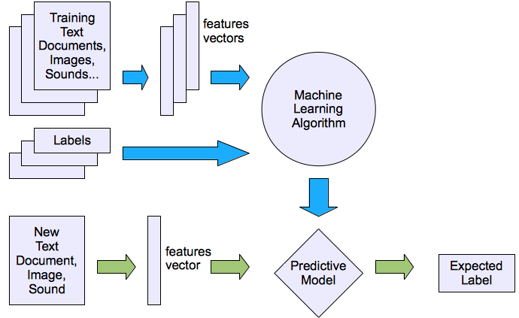

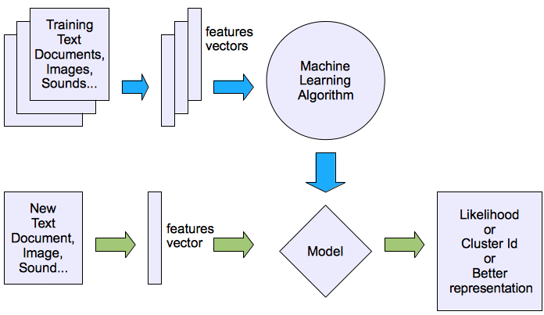
Machine Learning
Supervised
Classification (Nearest Neighbors, Support Vector Machines, Naïve Bayes, Decision Tree)
Group “like” things together based on selected features.
Regression (Linear & Logistic)
Infer a relationship between two variables (x) & result (y).
Unsupervised
Clustering (K Means)
Partition events with multiple numeric fields into clusters.
Decomposition(PCA, SVD)
Dimension Reduction, explains the maximum variance of the higher dimension
Notes:
There are two types of machine learning, Supervised (meaning it requires human input in order to produce a model) and Unsupervised (which requires limited human interaction to produce a model). The most important thing to keep in mind is combinations of both Supervised and Unsupervised are needed to produce and validate models.

Slide 35
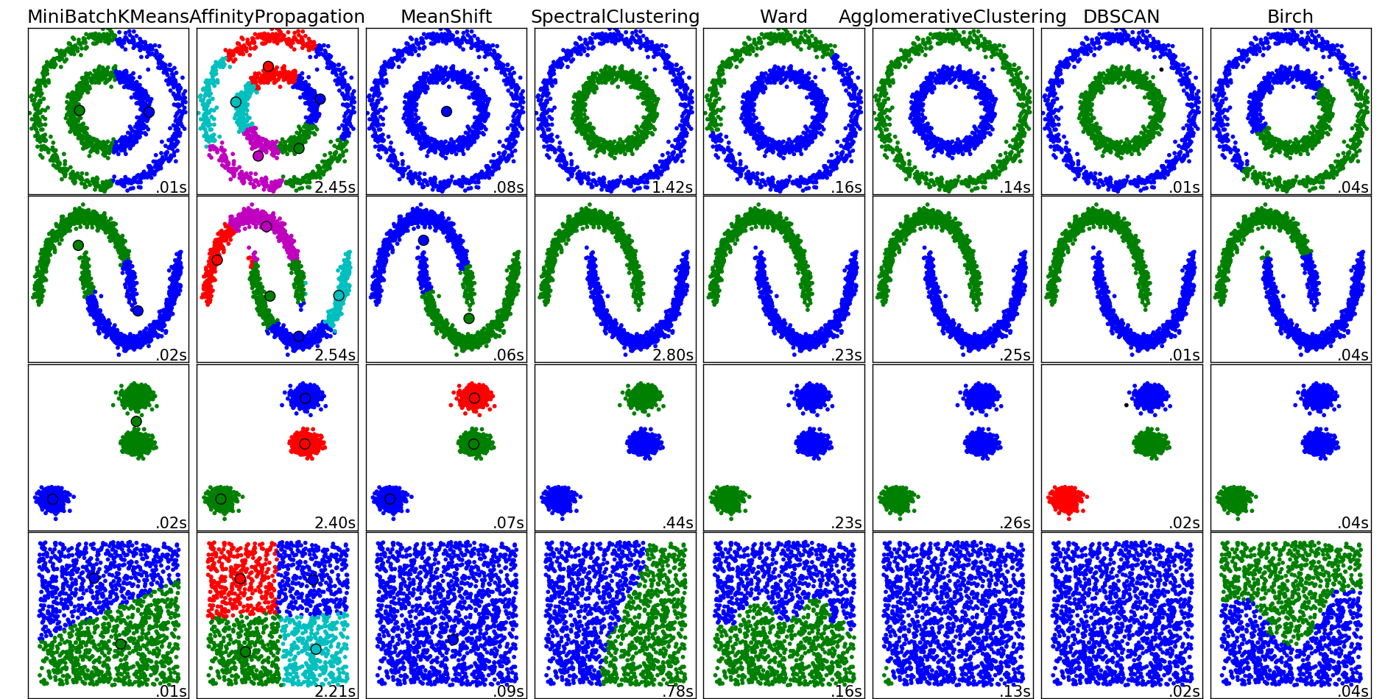
Machine Learning – Security Application
A toolset for asking research questions which we want to operationalize.
Problem: BotNet DDoS attacks are problematic for all size of organizations. They take a time, money and manpower to resolve. The IP addresses are dynamic making simple whitelist/blacklist mitigation not feasible.
Hypothesis: “Are there patterns in botnet network activity that can be leveraged to identify the specific botnet and mitigate the threat posed by that botnet?”
Notes:
So what can we do with this you might be asking? Well as we saw earlier we could determine likely Mirai traffic by creating a behavioral signature sourced from our ssh logs and other sources. What if we could categorize botnets by features? Secondly what if we could create a model predict the botnet attacking us based on the relationship between those features, then apply that model to new data to find events our correlation search may not have surfaced.

Slide 36
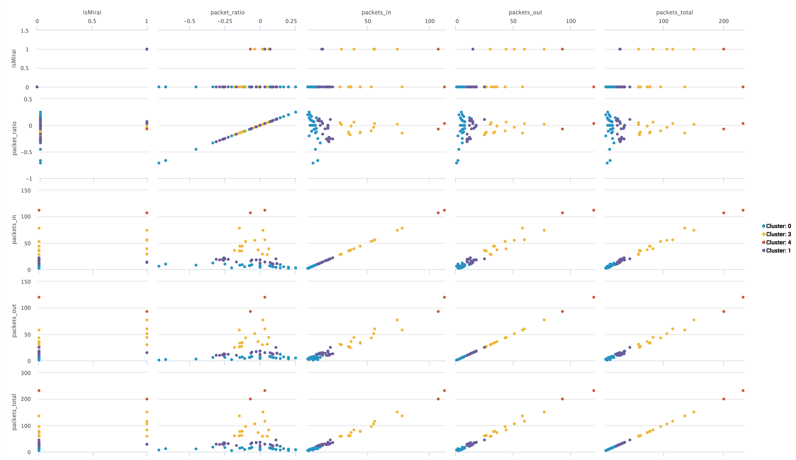
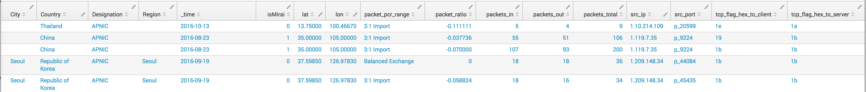
Machine Learning – Security Application
50k random Suricata flow events, dest_port=22
Features: packet_ratio, packets_in, packets_out, packets_total
Labels: isMirai = 1 or 0
Kmeans Cluster
K=5
Notes:
So what can we do with this you might be asking? Well as we saw earlier we could determine likely Mirai traffic by creating a behavioral signature sourced from our ssh logs and other sources. What if we could categorize botnets by features? Secondly what if we could create a model predict the botnet attacking us based on the relationship between those features, then apply that model to new data to find events our correlation search may not have surfaced.

Slide 37
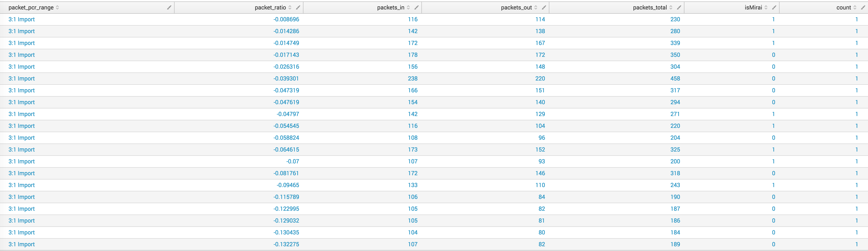
Machine Learning – Security Application
Cluster 4 is an outlier
Characteristics of Cluster 4
Notes:
ML toolkit allows us to extend the native Splunk capabilities to predict whether certain entropy scores correlate with malware or a cloud provider. This allows us to iteratively classify larger sets of data and find potential malware or DLP missed by our HIPS/IPS sensors.

Slide 38
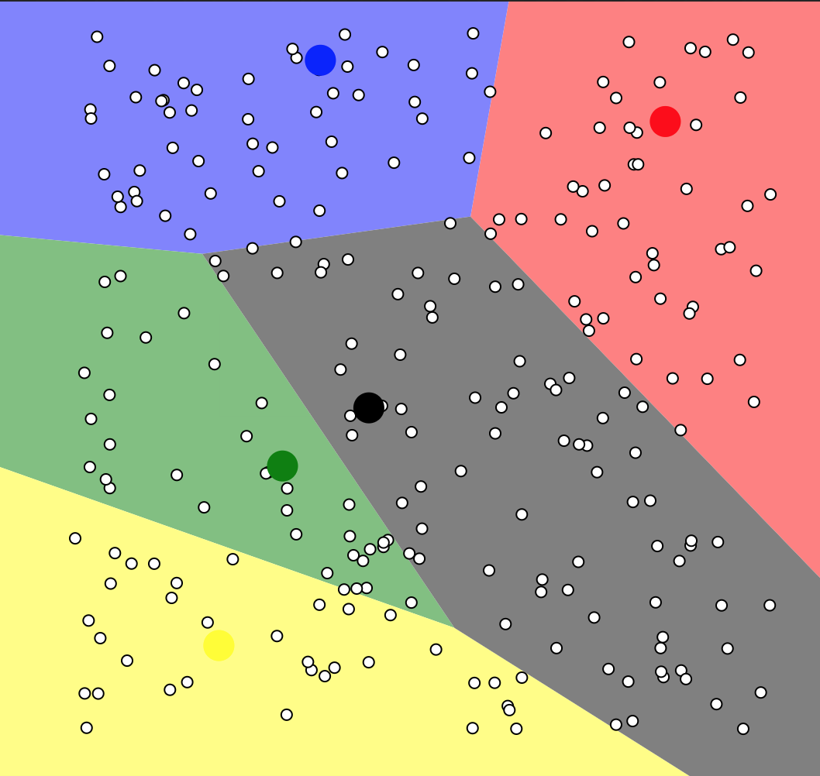
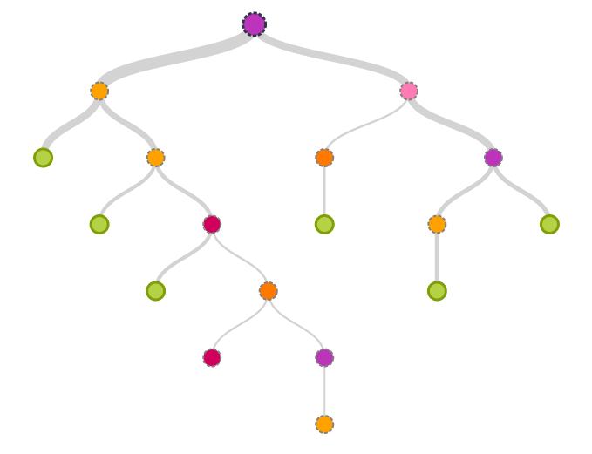
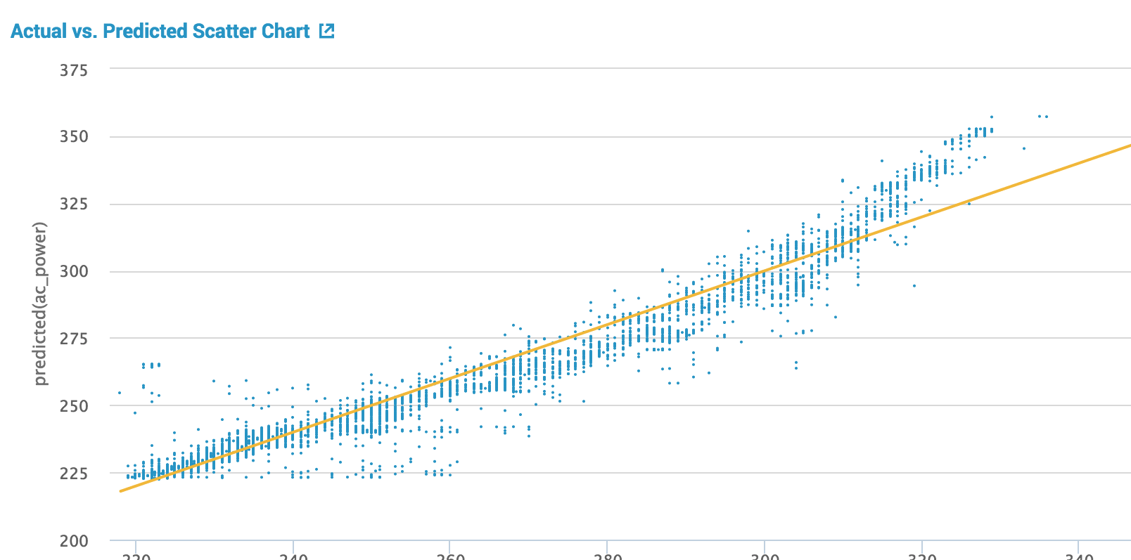
Machine Learning – Security Application
We now have a model which describes different Botnet populations.
Let’s use this model to predict if the connection is Mirai based on Cluster Distance
Cluster Distance
Describes the distance from a centroid
Prediction Algorithms:
Linear Regression
Decision Tree
Random Forest
Notes:
This allows us to iteratively classify larger sets of data and find potential malware or DLP missed by our HIPS/IPS sensors.

Slide 39
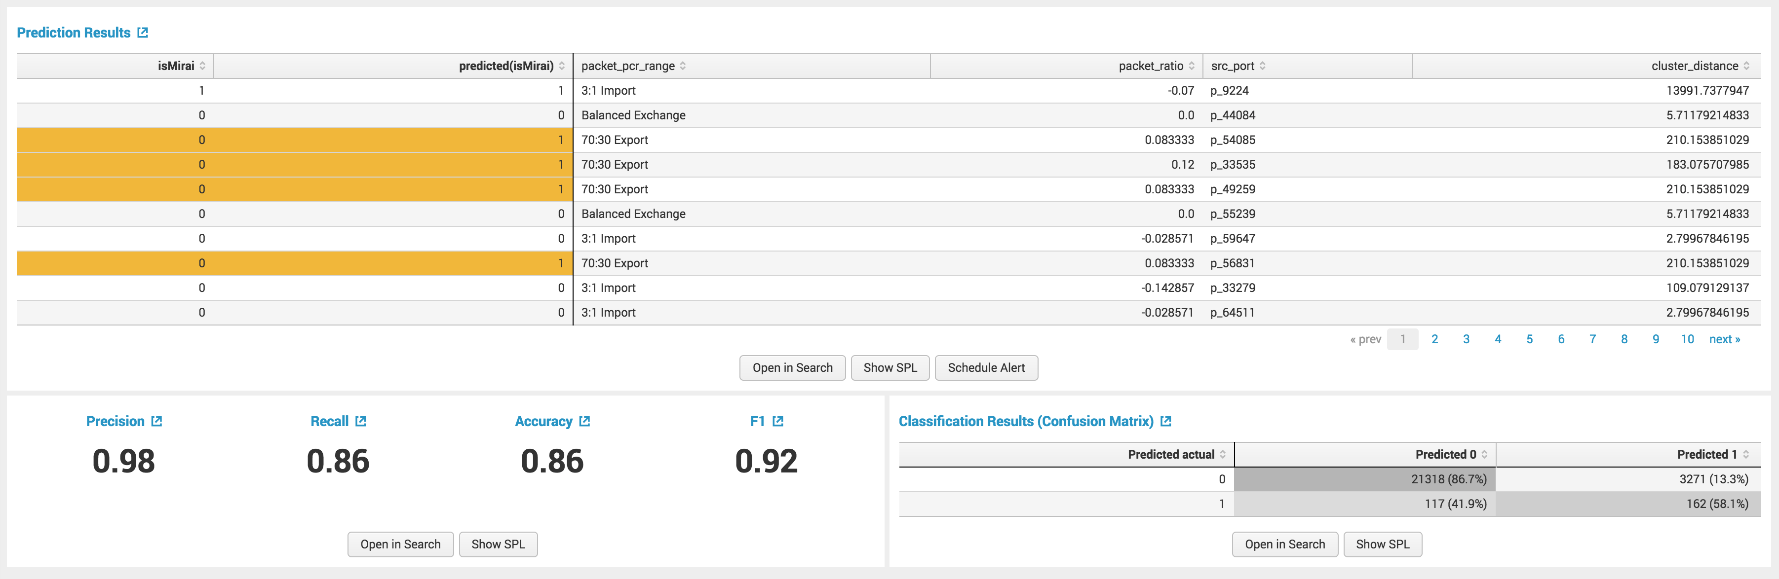

Machine Learning- Predict Mirai
Linear Regression
Results
High precision at predicting 0
13.% False positives
41.9% False Negatives
58.1% Correct at getting Mirai Traffic correct
Summary
IPS sensor allowed all of these connections (Not Blocked), while we missed 41.9% of these attacks.
We now have a model which we can further refine to identify malicious SSH traffic to investigate.
Adds a new layer to our security stack

Slide 40
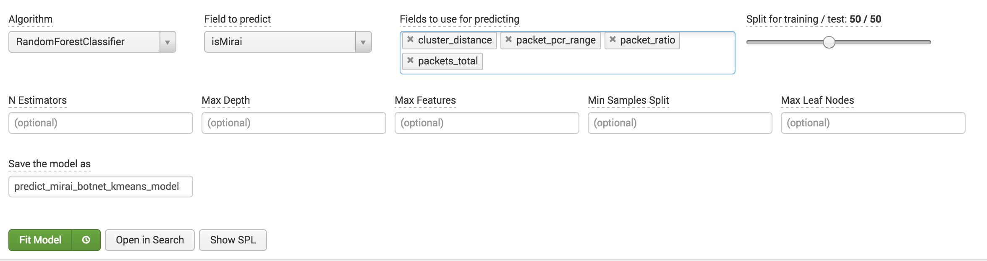
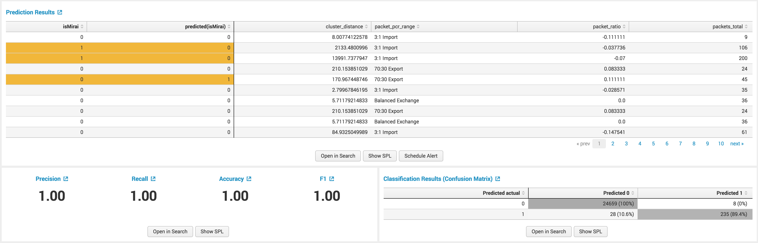
Machine Learning- Predict Mirai
Random Forest
Results
High precision at predicting 0
Small false positive (8/25,000)
10.6% False Negatives
89.4% Correct at getting Mirai Traffic correct
Summary
IPS sensor allowed all of these connections (Not Blocked), while we missed 10.6%
We now have a model which we can further refine to identify malicious SSH traffic to investigate.
Adds a new layer to our security stack

Slide 41

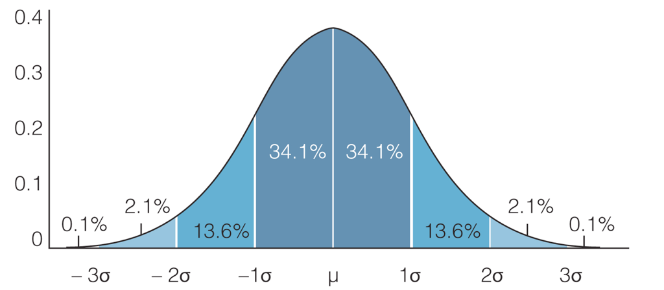
Machine Learning – Next Steps
Model is quite accurate because there *may* be an indicator of compromise it has found.
How to validate:
Assume Null Hypothesis
Add more data
Validate Variance & Entropy
Work with peers to cross validate model

Slide 42
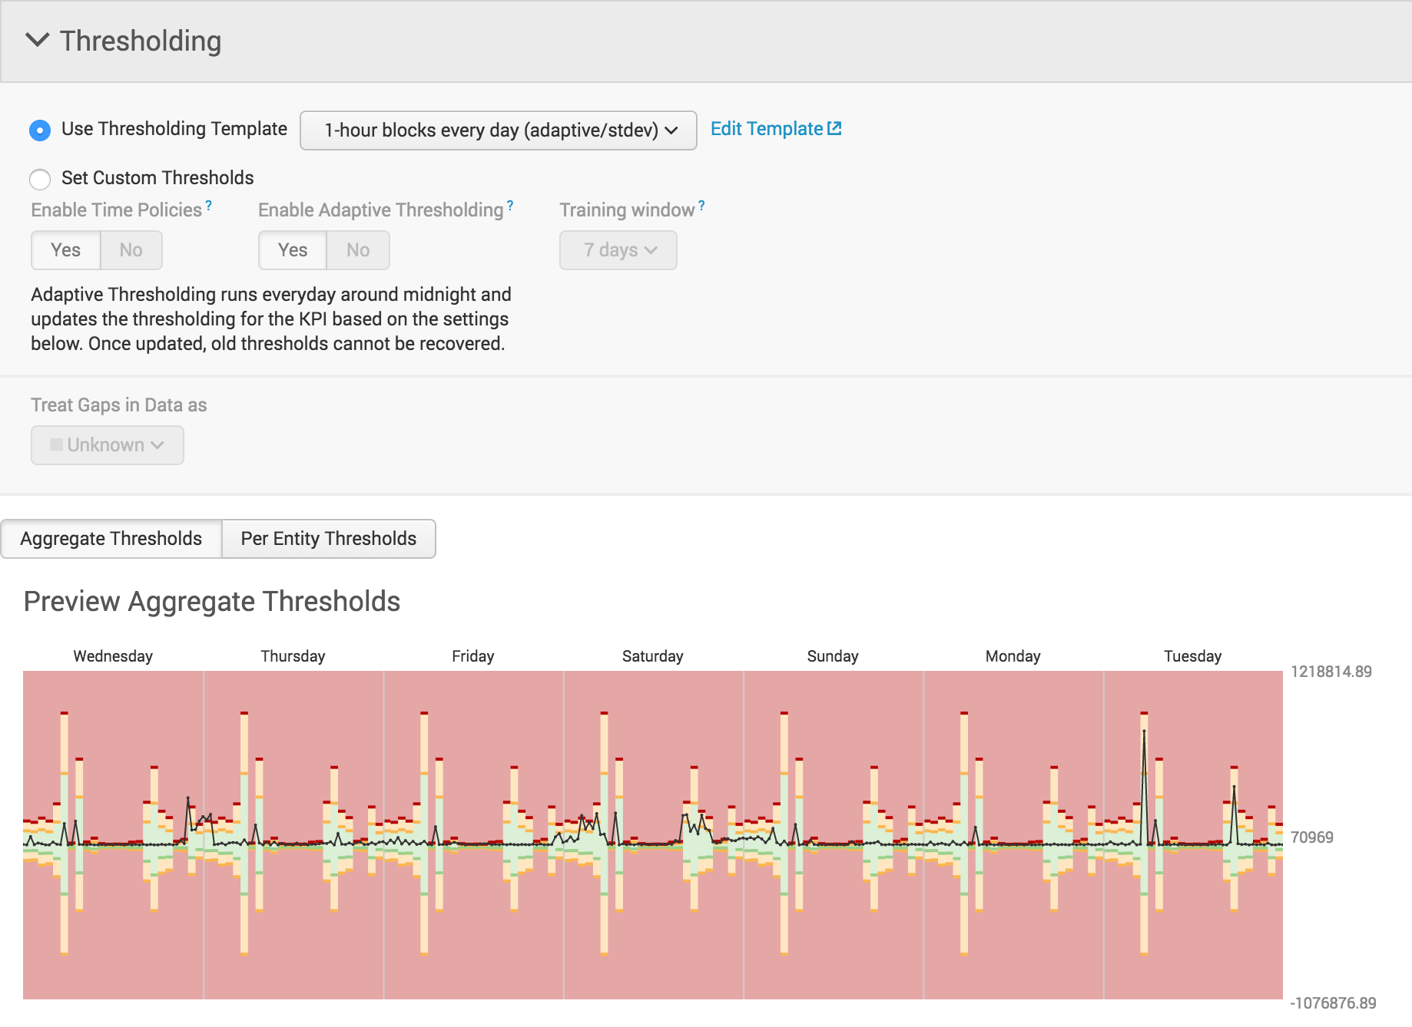
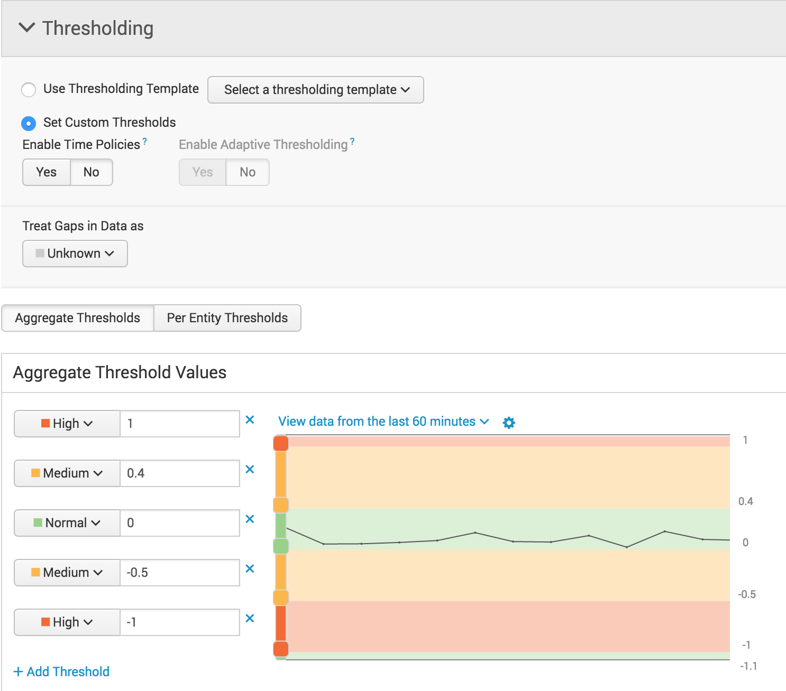

Machine Learning - Adaptive Thresholding
Make use of eval to create bytes_total & bytes_ratio for Producer Consumer Ratio (PCR) for KPI Base Search & NetFLOW
index=suricata event_type=flow | eval bytes_total=bytes_in+bytes_out | eval bytes_ratio= ((bytes_out-bytes_in)/bytes_total)
Thresholding score compares the current traffic against a rolling hourly average and standard deviation from mean for last 30 days of data.
Bytes Ratio Thresholds based on PCR Static Ratios
1.0 – pure push - FTP upload, multicast, beaconing
0.4 – 70:30 export - Sending Email
0.0 – Balanced Exchange - NTP, ARP probe
-0.5 – 3:1 import - HTTP Browsing
-1.0 – pure pull - HTTP Download
RISE OF THE MACHINES
Notes:
Taking this a step further, machine learning was added in ITSI 2.3/2/4. We can take the producer consumer ratio and create adaptive thresholds based on training windows. This allows us to create KPIs!

Slide 43
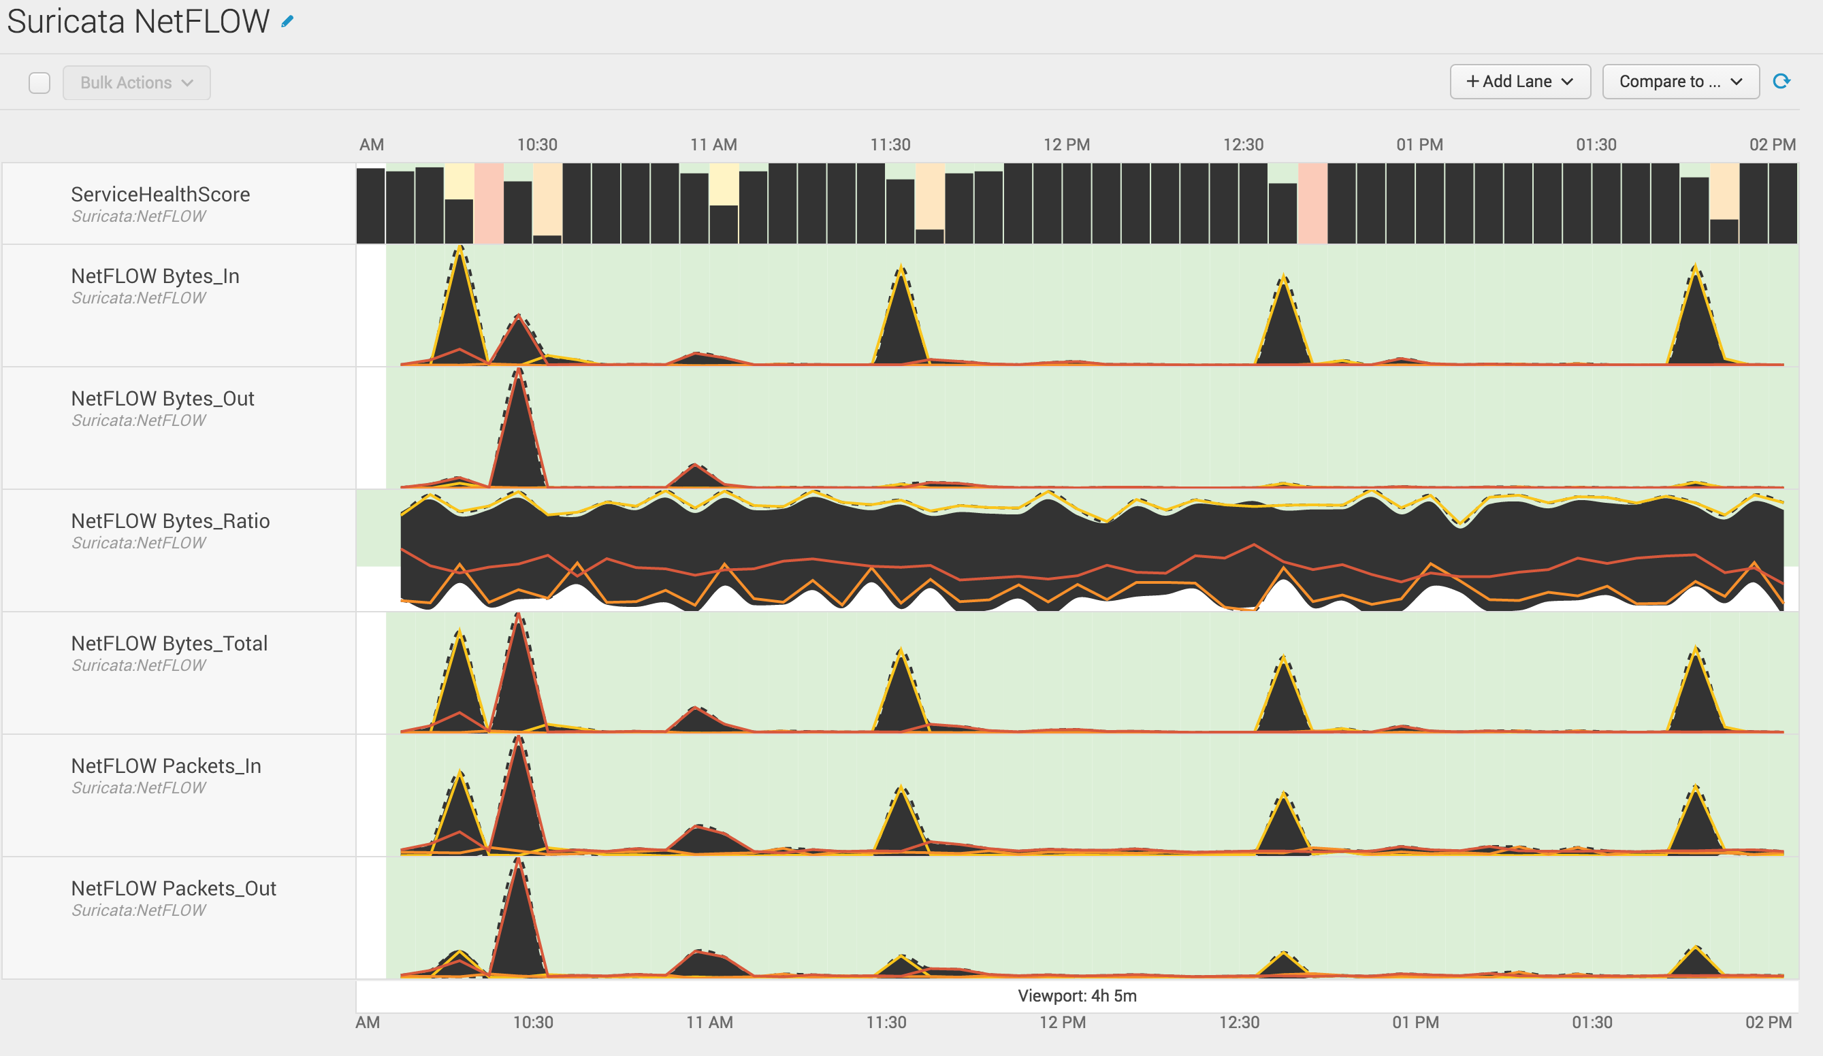
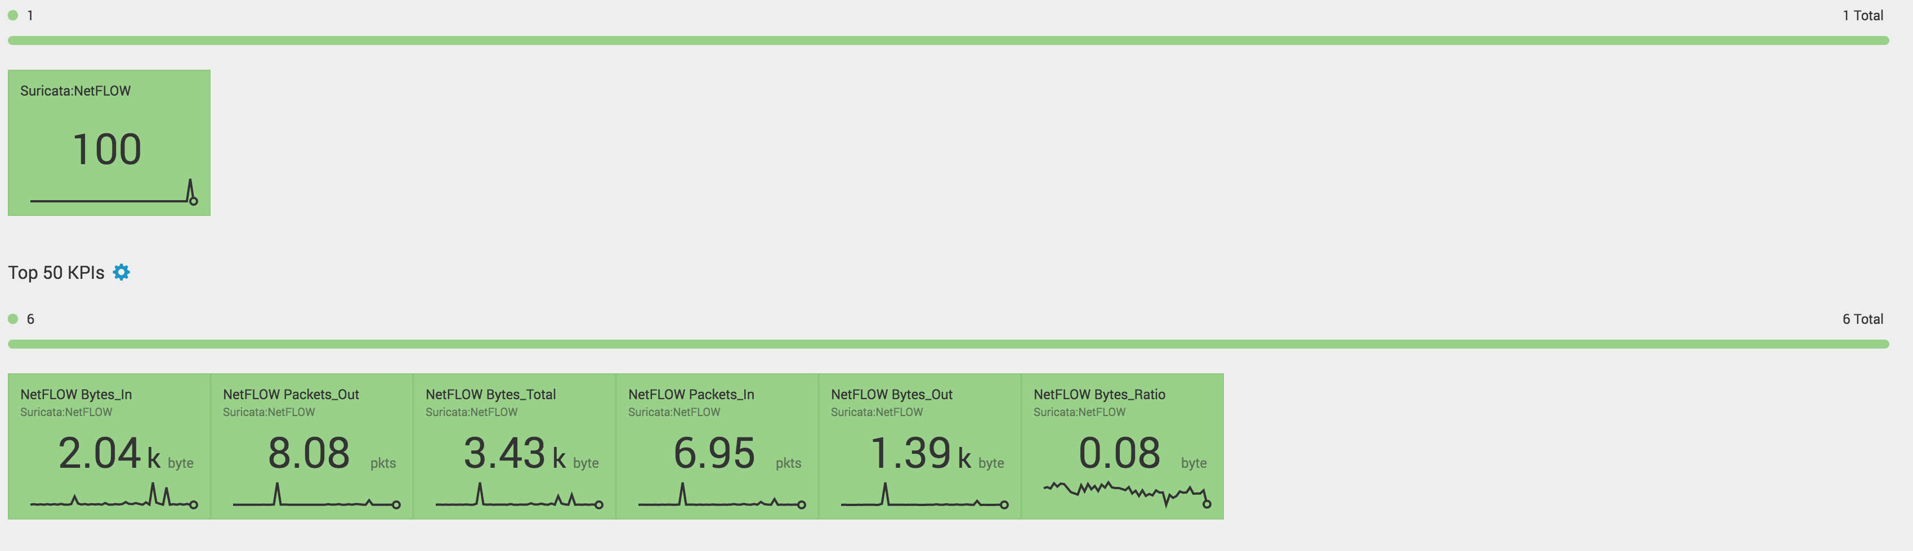
Machine Learning - Adaptive Thresholding
Visualization of the same PCR Suricata Flow
Health score based on 5 KPIs. The current traffic (bytes_in, bytes_out, bytes_total, packets_in, & packets_out) compared to a rolling hourly average, and standard deviation from mean.
Attempting to define ”What is normal and when is something deviating from the norm I’ve seen for 30 days?”
Bytes Ratio based on PCR Ratio for thresholding.
Notes:
These particular KPS create health scores based on a rolling hourly average. We are making use of ITSI to determine what is normal, and when has the traffic flow changed in my environment? An increase in traffic might co-inside with a DDOS attack or some other high traffic event. ITSI allows us to deep dive and answer these questions. A spike in bytes our might coincide with data exfiltration from a successful malware campaign.

Slide 44

Recap
√ 5 Step Data Science Methodology for Security
√Descriptive Statistics
√Quantitative vs Qualitative Analysis
√Exploratory Data Analysis (EDA)
√Machine Learning
Notes:
RECAP

Slide 45
Thank You

Slide 46
Glossary
Descriptive Statistics
Min, Max, Median, Average(Mean), Standard Deviation, Mode
Z-Scores
Exploratory Data Analysis
Searching the data and looking for relationships
Leveraging knowledge ( lookups , reference tables )
Entropy
Measurement of how mixed up something is
e.g. non-numerical field such as query compared against wordlist
P-Values
“The p-value is defined as the probability of obtaining a result equal to or "more extreme" than what was actually observed, when the null hypothesis is true.”

Slide 47
Explore Splunk Analytics
Anomalies
Analyzes numeric fields for their ability to predict another discrete field.
Anomalousvalue
Computes an "unexpectedness" score for an event.
Anomalydetection
Finds and summarizes irregular, or uncommon, search results.
Cluster
Computes a probability for each event and detects unusually small probabilities.
Kmeans
Groups similar events together.
Outlier
Removes outlying numerical values.
Rare
Displays the least common values of a field.

Slide 48
References & Resources
Spurious Correlations http://www.tylervigen.com/spurious-correlations
PCR – A New Flow Metric http://qosient.com/argus/presentations/Argus.FloCon.2014.PCR.Presentation.pdf
Data Driven Security http://datadrivensecurity.info/
Splunk Syntax Highlighting http://blog.metasyn.pw/splunk-syntax-highlighting/
Doing Data Science http://shop.oreilly.com/product/0636920028529.do
Hunting the Known Unknowns (with DNS) https://conf.splunk.com/speakers/2015.html#search=Kovar&
Lookups, and other goodies https://github.com/anthonygtellez/conf2016_extras
IDS Evasion w TTL - http://insecure.org/stf/secnet_ids/secnet_ids.html
Applying Machine Learning to Network Security Monitoring http://www.mlsecproject.org/#conference-presentations
Scikit-Learn http://scikit-learn.org/
Machine Learning Toolkit https://splunkbase.splunk.com/app/2890/
URL Toolbox https://splunkbase.splunk.com/app/2734/

